Slide 1
Turnitin
Student guide

Slide 2
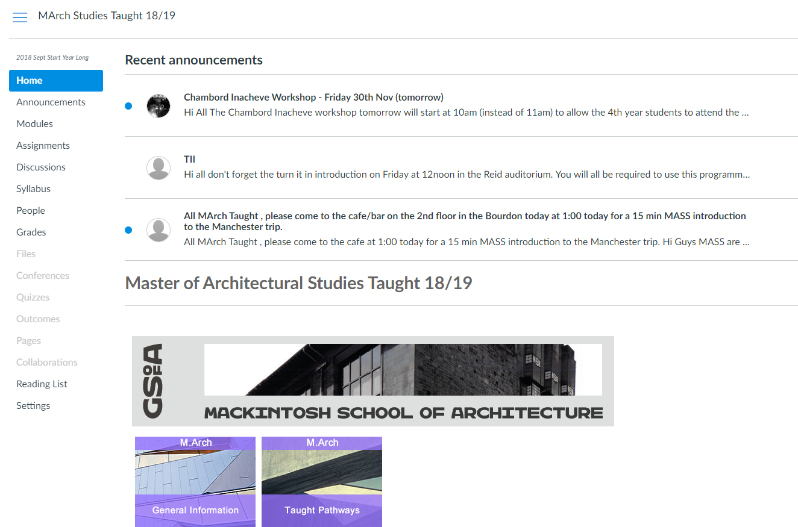

Slide 3
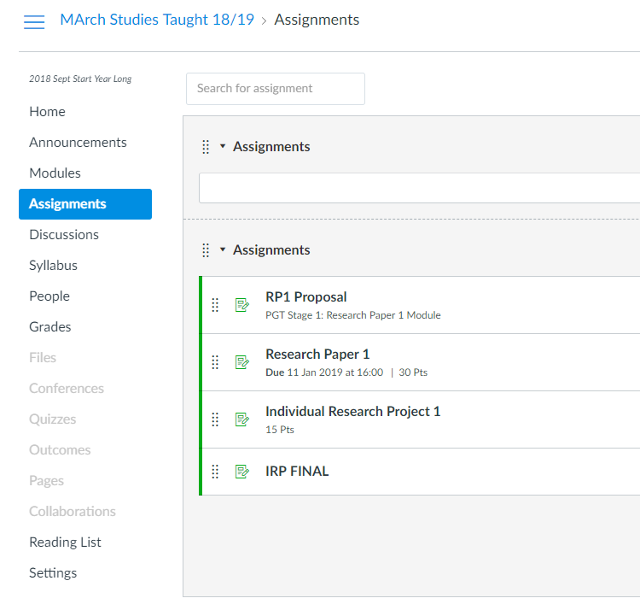

Slide 4
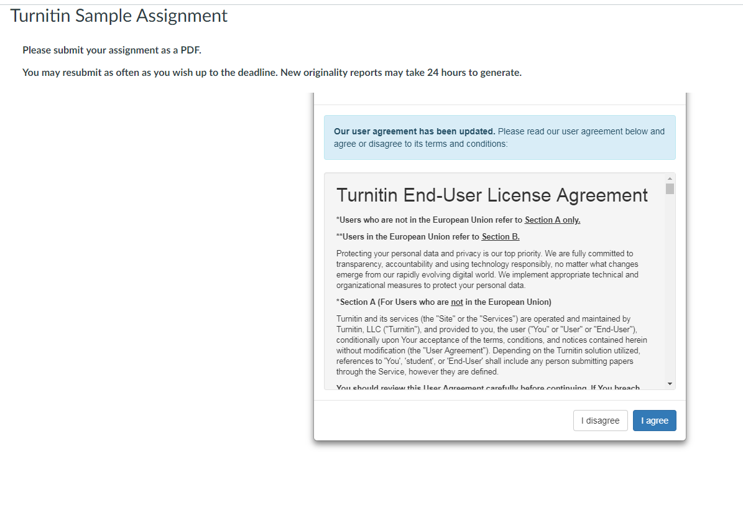

Slide 5
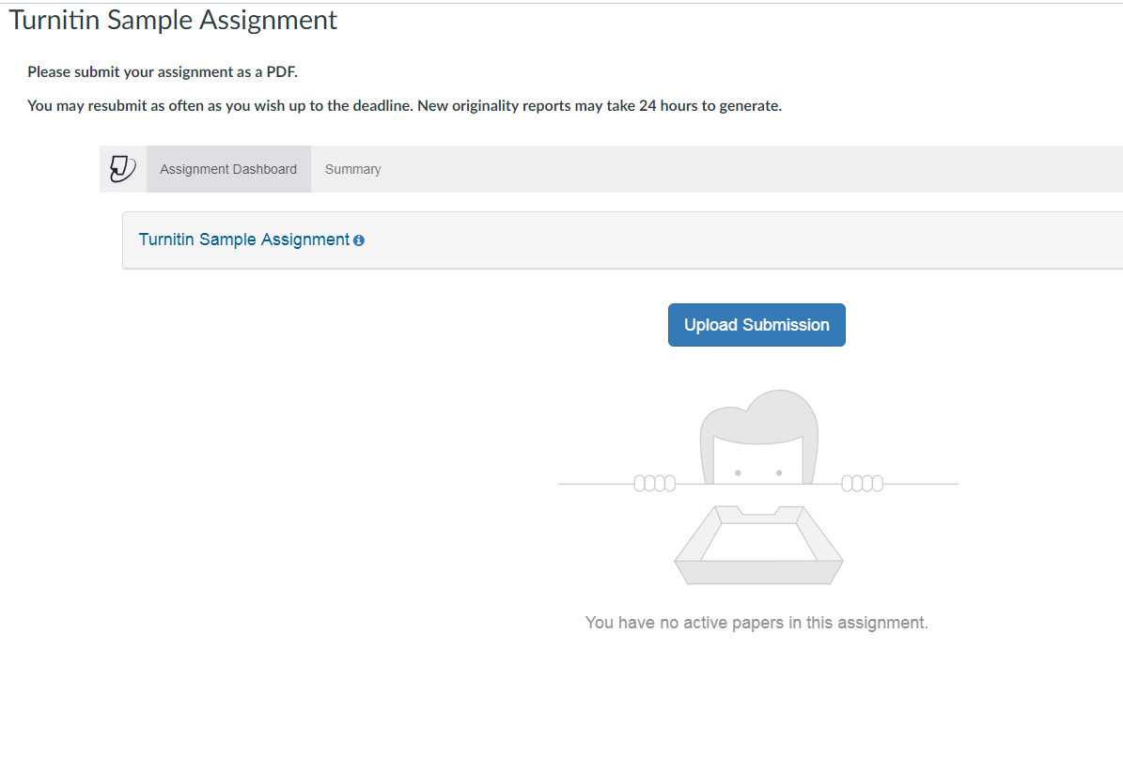

Slide 6
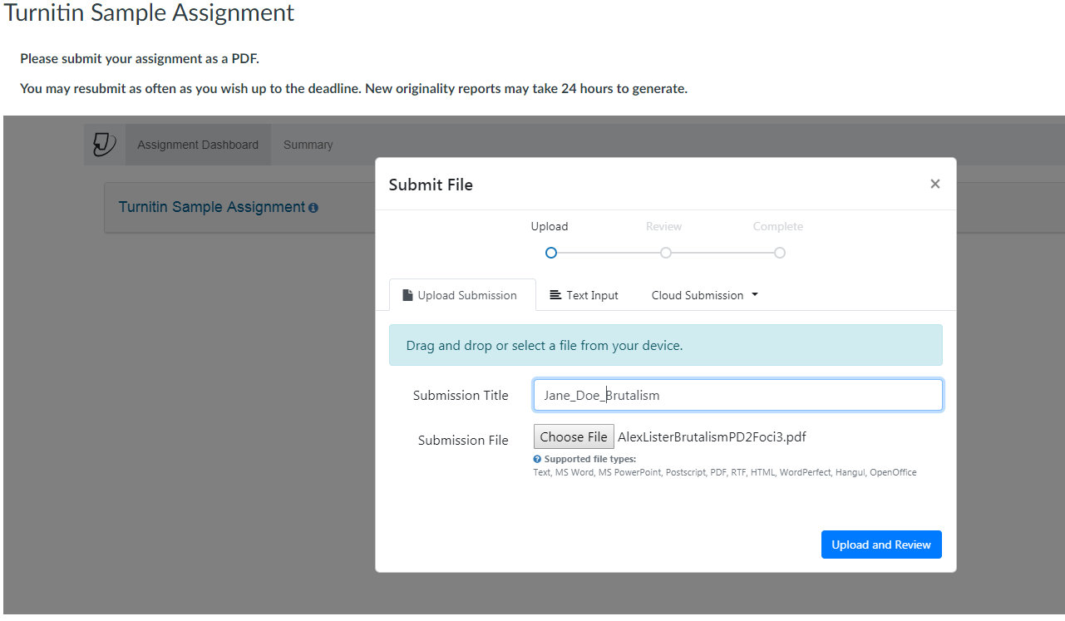

Slide 7
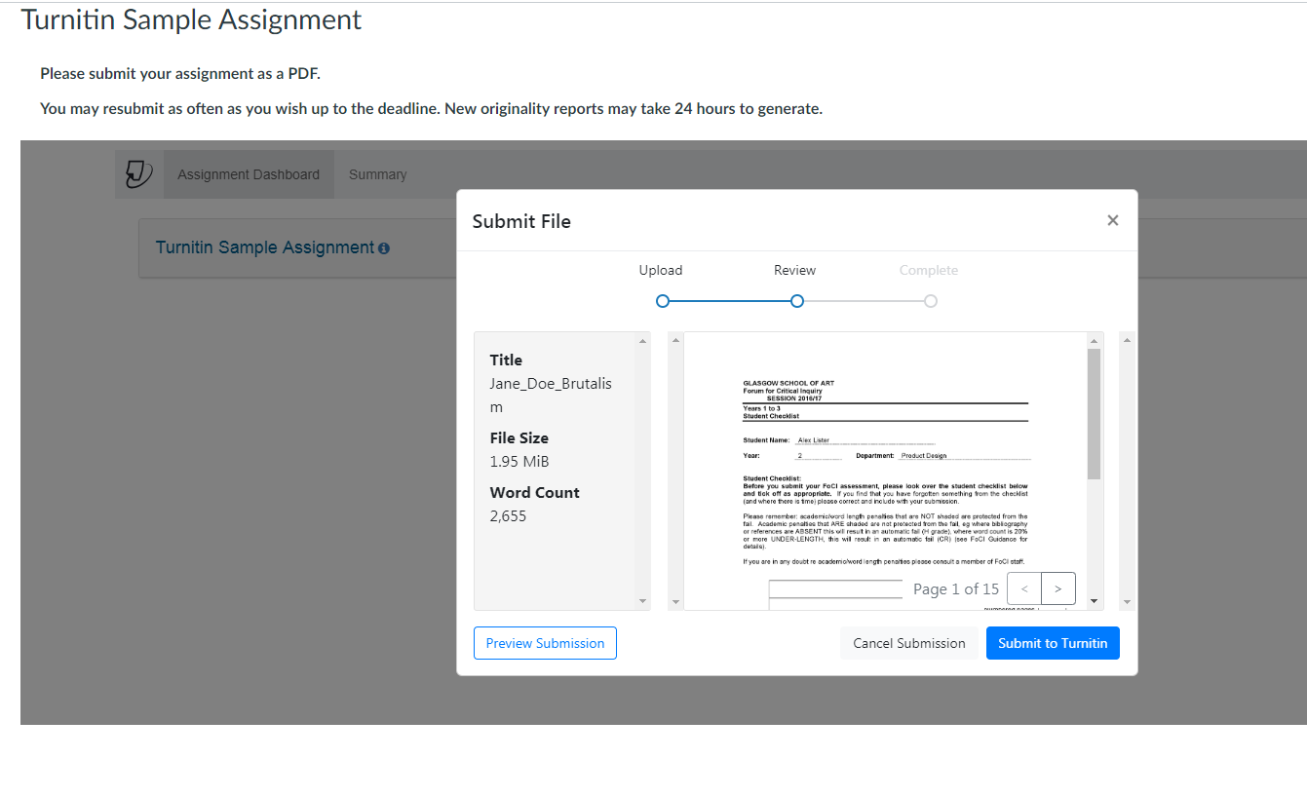

Slide 8
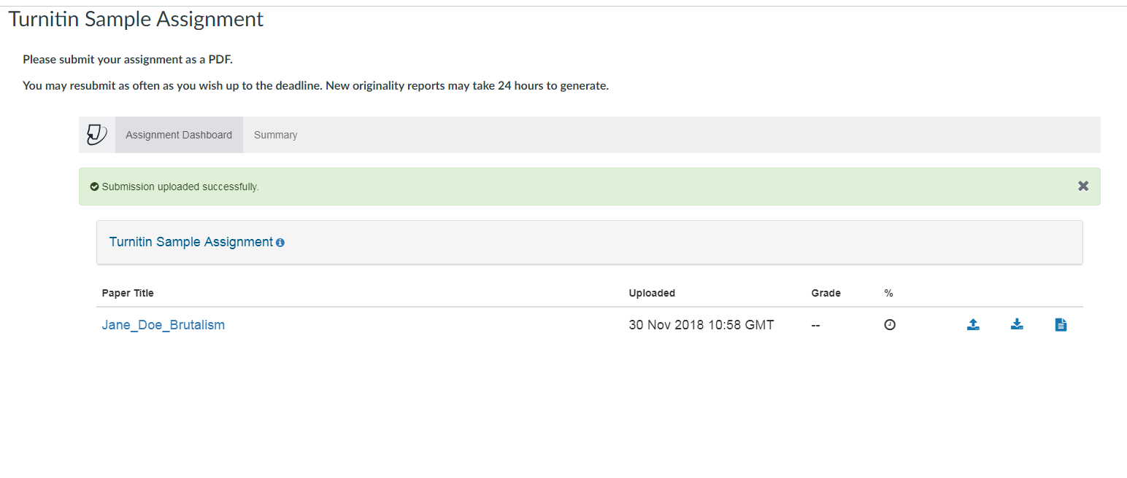
Similarity Report Generator
Clock indicates report is being generated
Coloured square will be green, yellow or red (according to percentage of matching content). Click on Square or number to view the report.

Slide 9
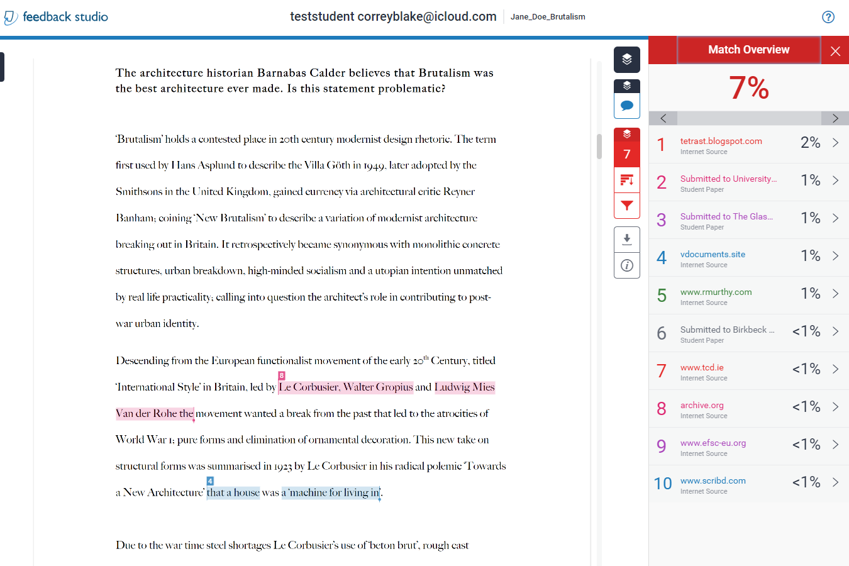
FEEDBACK STUDIO: View Your Originality Report online

Slide 10
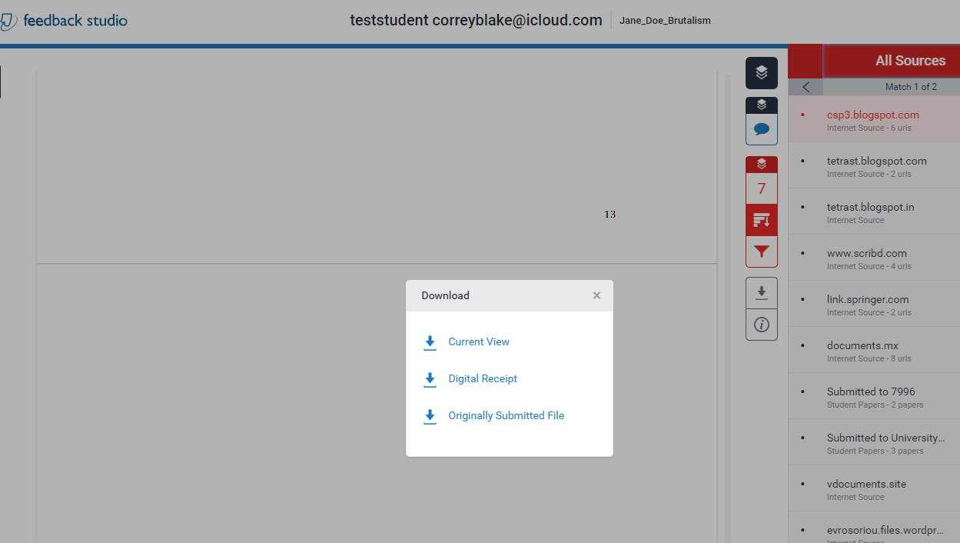
Or…Download your Originality Report

Slide 12
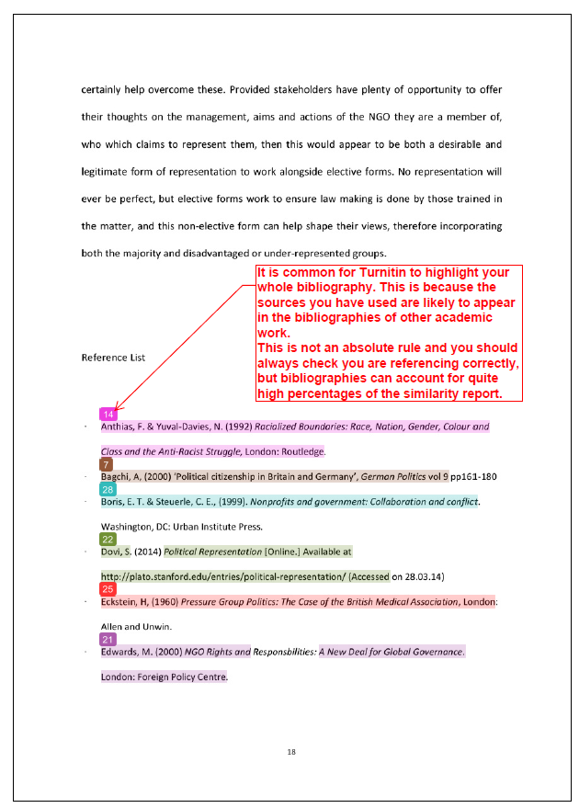

Slide 13
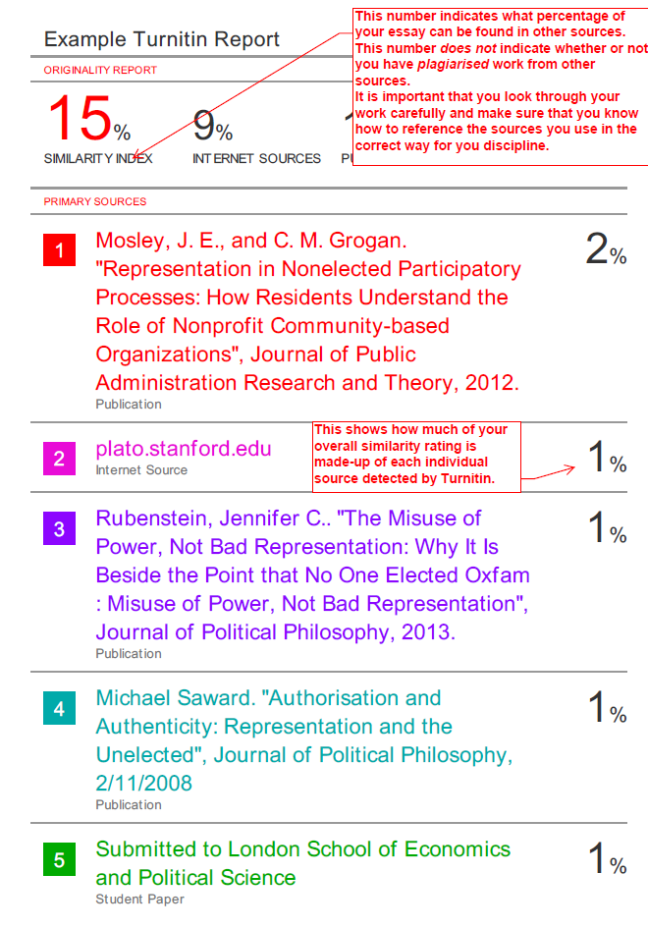
View this sample report on your Canvas architecture course.

Slide 14
Final Points
Turnitin is used for Formative Assessment to help you identify your referencing and use of sources.
Just because Turnitin highlights something, this does not mean it is not valid, or is plagiarism. Proper referencing is all that is usually required.
Any questions with Turnitin contact lthelp@gsa.ac.uk

